Slide 1
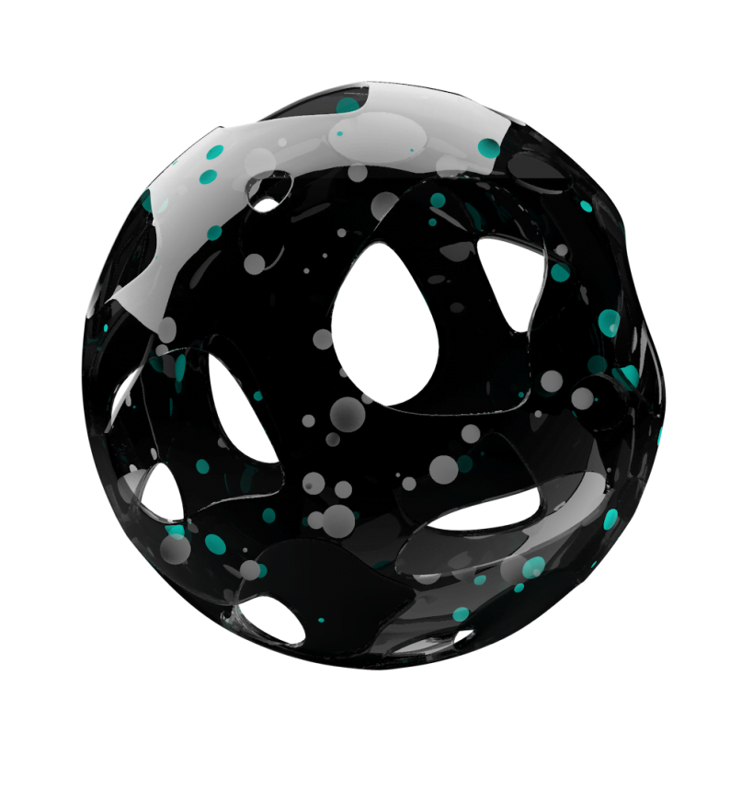
Privacy
And
Voice Screening
For Environmental Sound Identification
Notes:
Imagine you’re on holiday with your partner or your family. You have your own private corner of bush, no one else around. You relax, explore, spend time together. Then, one month later, you find out that your conversations were recorded and someone in an office three hours away has listened to them. How would you feel?

Slide 2
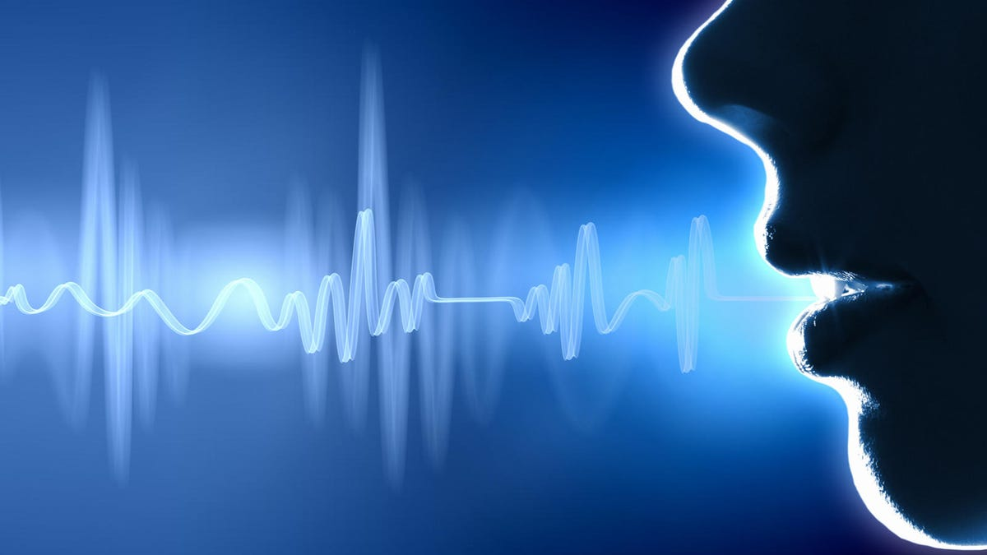

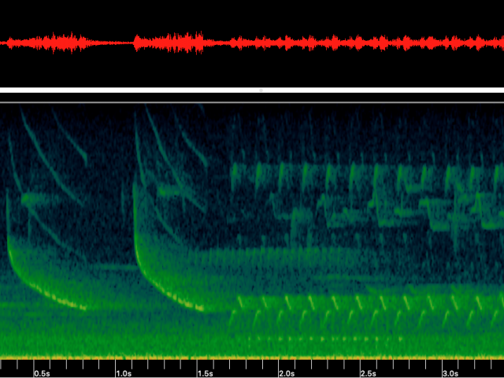
The Privacy Problem
How would you feel
if a private conversation was recorded
without your consent?
Notes:
I think most people would be uncomfortable with this. Their privacy was violated.
Why would this happen?

Slide 3

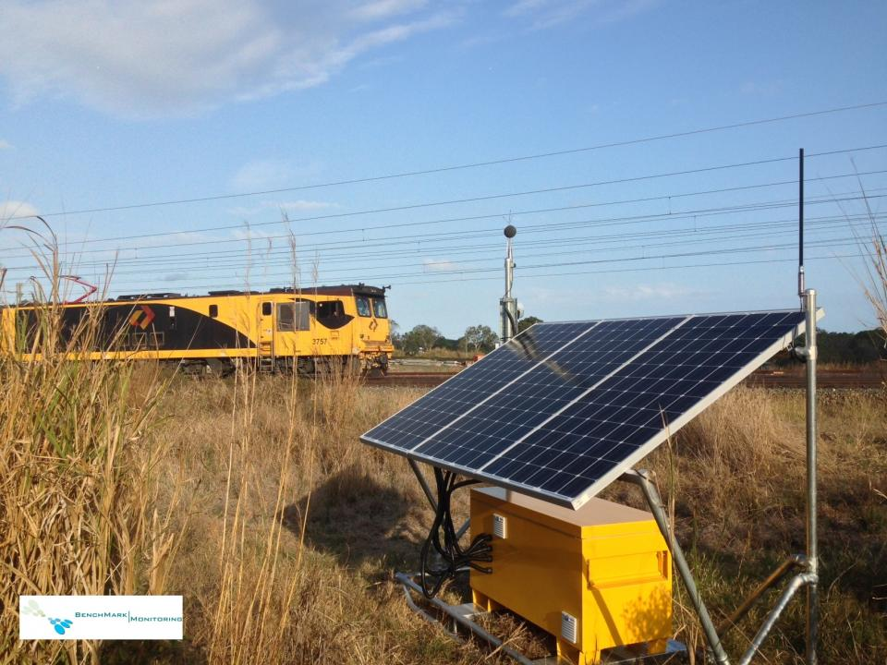
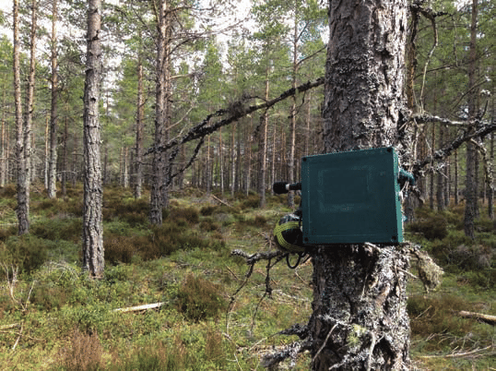
The Contexts : Environmental Sound Identification
For Industrial Noise Management
For Environmental Management
Notes:
Environmental sound identification - using AI/Machine learning to classify audio
Industrial applications: measure noise pollution, track vehicle movement Environmental applications - survey bird/insect/frog populations, track human or animal movements
Requires high quality sound data – hence voice and conversations are recorded

Slide 4
What is the Current Solution?
NOTHING!
Notes:
What is currently being done to protect the privacy of people near the monitors?
*shrug*
So we came up with a solution

Slide 5




The Solution - Pre-Screening
Preprocessing
ML Model – Voice Yes / No
Does this contain voice data?
Raw Audio Data
Yes
No
Discard data
Continue routine assessment
Notes:
Develop a simple ML model that can identify whether or not audio data contains a voice – by keeping the model goals small, time, computation, and power consumption is minimal
Install on the device in the field and apply immediately after recording
If voice is identified, exclude the data from further analysis and mark it as voice (for traceability)
The monitor functions as normal, but voice data is excluded at the earliest possible point in the process (and is never stored) – minimising privacy impacts

Slide 6
Stakeholders
 | Low interest | High interest
High impact | Engage as needed | Manage closely
Low impact | Monitor | Keep satisfied
Notes:
[discuss the stakeholders]

Slide 7
What We Bring to Target Customers
Protection
from legal concerns
Responsible practice
Less data to store
Notes:
Customers are important! Our project should benefit them and they should want to use it even if there’s no law requiring them to
For manufacturers and operators of noise logging systems, our solution provides multiple benefits all with minimal impact to current operation
-Responsible practice – promote to your customers and to the general public
-Less data to store
-Protection from legal concerns

Slide 8
Ensuring our Solution is Responsible
Works equally well for all people
What if capturing the voice data is desirable?
Notes:
Ideally, the screening should successfully identify voice regardless of whether it’s male or female, across all languages and accents. This requires a robust dataset with representative samples of all relevant voice types. If it’s less effective for certain groups of people, these should be identified. Regional differences (eg language) mean the software might not be suitable for use in these regions. Male/female differences mean the model should be revised.
There might be situations where inadvertently recording voice data is useful – eg if the monitor records a crime in progress. How valuable is privacy vs the social benefit of surveillance? This will depend on culture and context

Slide 9



The Solution Details
Once sufficient data is cached (~5s), apply speech recognition model
Cache of input data
Input data 1/3 octave, short time step (<1 s, often 125 ms)
Speech recognised
No speech recognised
Cache data waiting for voice screening
Set data in cache to 0
(do not delete entry, just clear values)
Core data analysis/ML classification
Release cached data
Notes:
The monitor initially collects the audio data in high detail
Recognising voice takes at least a few seconds of input – so store the data in a temporary cache until there is enough
Run the voice identification algorithm over the data in the cache – it returns a YES (there is voice) or NO (no voice)
If YES – set the cached data to 0 – this makes it clear that voice data has been filtered out
Send the cache into the rest of the analysis process

Slide 10

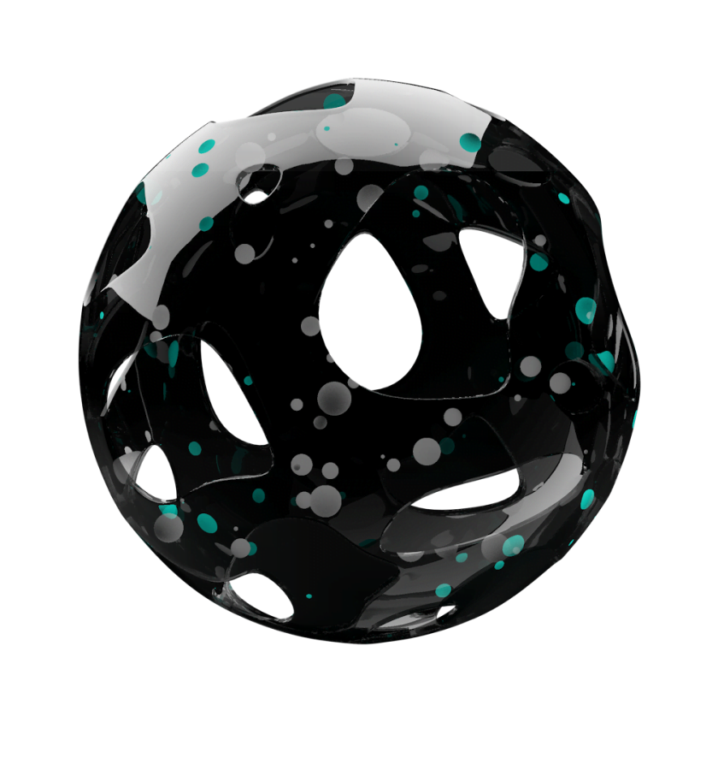
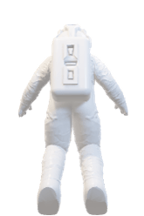
THA
NKS

Slide 11
Why our solution？
Minimal impact to the monitor’s function
Prevents sensitive data from being stored
Data is screened at earliest possible point in the process
Notes:
The monitor can still function as normal
Sensitive data is never stored – removes privacy concerns as early as possible
Importantly, it’s streamlined
By focusing on only whether data is voice or non-voice, much less computation is required than standard voice recognition

Slide 12

Important Goals
The rest of the system works just as well
Adaptable inputs
Accurate classification
Traceability
Low resource use
行业PPT模板http://www.1ppt.com/hangye/
Notes:
Voice identification shouldn’t compromise the system’s function
Ideally work with whatever the system’s input is – our process should be adaptable
Clearly record when data is excluded
Monitors are usually in remote environments - power and network connection comes at a cost
Ensure representative voice identification (vocal range, accent, language)

